Slide 1


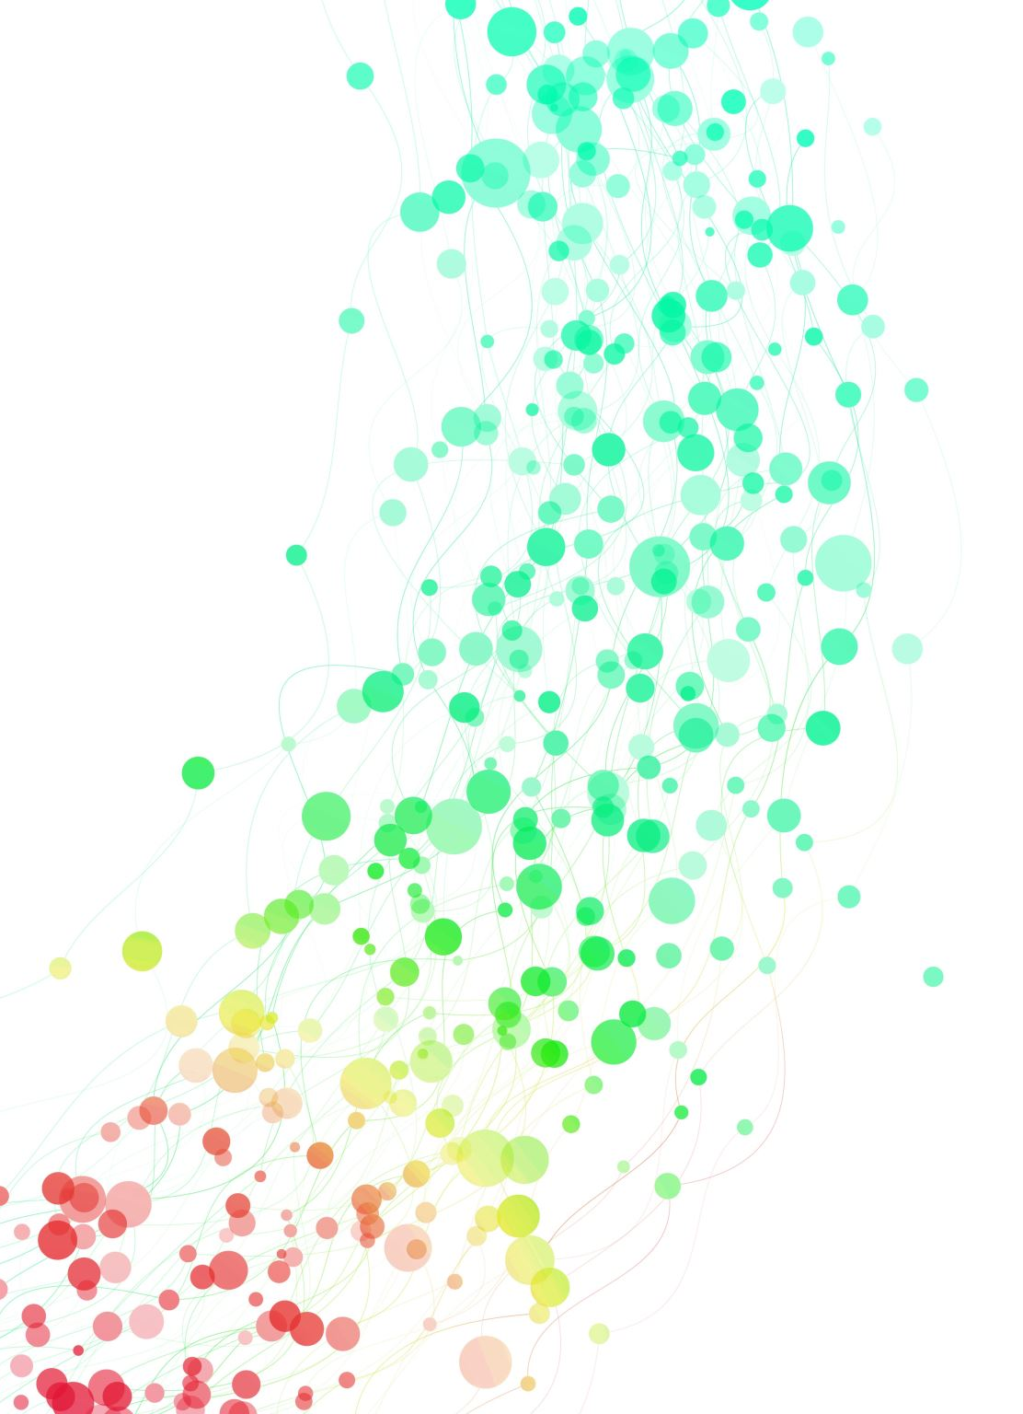



Digital Marketing Campaign for Odel
Author: Sergio Gomez Ortiz

Slide 2
Overview
CHALLENGES FOR BUSINESS ORGANISATIONS
OPPORTUNITIES FOR BUSINESS ORGANISATIONS
INTRODUCTION TO THE DIGITAL MARKETING CAMPAING
TOOLS AND TECHNIQUES
DEMOSTRATION OF THE WEBSITE
EFFECTIVE MARKETING
CALL TO ACTION
MEASUREMENT TECHNIQUES
IMPROVE PERFORMANCE FOR THE STORE
KEY DIGITAL MEASUREMENT TECHNIQUES & PERFORMANCE METRICS
SUMMARY

Slide 3
Challenges for business organisations
Key Challenges:
- Keeping up with rapidly evolving technologies and platforms
- Standing out in a crowded and competitive digital landscape
- Ensuring consistent brand experience across multiple channels
- Measuring and attributing success across different touchpoints
- Maintaining data privacy and security in a digital world
Odel's Current Issues:
- Lack of digital presence (no website, social media, email marketing)
- Struggling to reach target audience and drive conversions
- Limited visibility and discoverability online
- Inability to leverage digital channels for marketing and sales
- Missing out on potential opportunities and revenue streams
Recommendations for Odel:
- Develop a comprehensive digital marketing strategy
- Establish a strong online presence (website, social media, email)
- Leverage SEO, PPC, and content marketing to drive visibility
- Implement data-driven targeting and personalization
- Continuously monitor and optimize digital marketing efforts
- Allocate dedicated resources and budget for digital initiatives

Slide 4
Opportunities for business organizations
Key Opportunities:
Reach a global audience cost-effectively
Targeted and personalized marketing efforts
Measurable and data-driven campaigns
Omnichannel customer experiences - Increased brand awareness and customer engagement
Direct sales and e-commerce opportunities
Opportunities for Odel's Digital Marketing Campaign:
Establish a strong online presence and brand identity
Connect with customers across multiple digital channels
Leverage data and analytics for targeted marketing
Implement omnichannel strategies for seamless customer experiences
Drive online sales and revenue through e-commerce platforms
Build customer loyalty and advocacy through engagement

Slide 5
Introduction to the digital marketing campaign
Overview:
Objective: Design and implement a digital marketing campaign for Odel
Aim: Increase website traffic, generate leads, and improve sales
Target Audience: All ages, races, religions, and genders
Tasks Achieved:
Conducted market research and audience analysis
Developed a comprehensive digital marketing strategy
Applied relevant digital tools and techniques
Created multimedia content (website, social media, email, video)
Implemented tracking and measurement tools

Slide 6
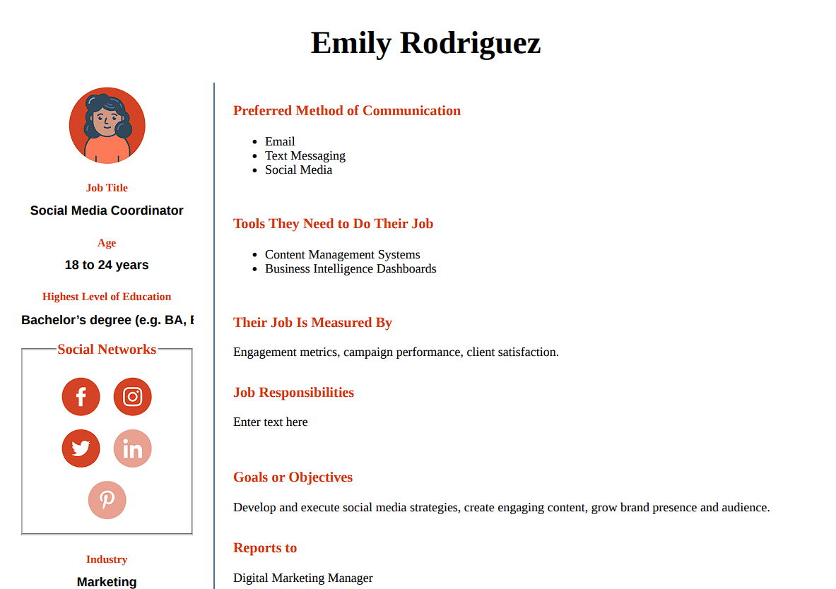
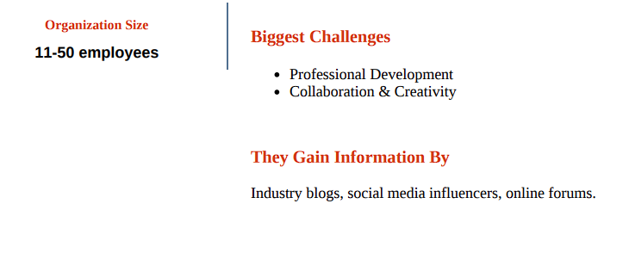
Introduction to the digital marketing campaign

Slide 7

Tools and Techniques
Key Digital Tools and Techniques:
- Social Media Marketing (Facebook, Instagram, Twitter, LinkedIn)
- Organic posts, paid ads, influencer marketing
- Email Marketing
- Email newsletters, promotional campaigns, automated sequences
- Content Marketing
- Blogging, whitepapers, infographics, videos
- Search Engine Optimization (SEO)
- Keyword research, on-page optimization, link building
- Pay-Per-Click (PPC) Advertising
- Google Ads, Bing Ads, social media ads
- Analytics and Tracking
- Google Analytics, social media analytics, CRM systems

Slide 8
Tools and Techniques
Discuss the effectiveness of using the digital tools in terms of reach, impact and cost.
Email Marketing:
Reach: Targeted to subscribers and existing customers
Impact: Effective for nurturing leads, driving conversions, retaining customers –
Cost: Low cost, highly scalable
Social Media Marketing:
Reach: High potential reach, ability to target specific audiences
Impact: Effective for brand awareness, engagement, customer acquisition
Cost: Relatively low cost for organic efforts, paid ads can be cost-effective
Search Engine Optimization (SEO):
Reach: Potential to rank higher in search results, increasing visibility
Impact: Effective for driving targeted organic traffic and conversions
Cost: Moderate cost for ongoing optimization, cost-effective long-term
Video Marketing:
Reach: Potential for viral sharing and reaching new audiences
Impact: Effective for showcasing products, storytelling, and building trust
Cost: Moderate to high cost for production, distribution can be cost-effective
Notes:
Email Marketing:
Reach:
Email marketing allows businesses to directly target their subscribers and existing customers, providing a focused and engaged audience (Chaffey and Ellis-Chadwick, 2019).
Impact:
Email marketing has proven to be an effective tool for nurturing leads, driving conversions, and retaining customers through personalized and targeted messaging (Laudon and Traver, 2017).
Cost:
Email marketing is generally considered a low-cost marketing channel, as the costs associated with email service providers and email campaign management are relatively minimal compared to traditional marketing methods (Tuten and Solomon, 2018).
Additionally, email marketing campaigns can be highly scalable, allowing businesses to reach a large audience with minimal incremental costs.
Social Media Marketing:
Reach:
Social media platforms offer businesses the potential to reach vast audiences, both through organic and paid efforts (Chaffey and Ellis-Chadwick, 2019).
Targeted advertising options on social media platforms enable businesses to reach specific audience segments based on demographics, interests, and behaviors.
Impact:
Social media marketing has proven to be an effective tool for building brand awareness, fostering engagement with customers, and acquiring new customers through targeted campaigns and influencer marketing (Tuten and Solomon, 2018).
Cost:
Organic social media efforts, such as posting content and engaging with followers, typically have minimal direct costs beyond the resources required to manage and maintain an active presence.
Paid social media advertising, such as sponsored posts and targeted ads, can be a cost-effective way to reach a specific audience, with the ability to adjust budgets and targeting based on performance (Laudon and Traver, 2017).
Search Engine Optimization (SEO):
Reach:
Effective SEO strategies can help businesses rank higher in search engine results, increasing their visibility and reach to potential customers actively searching for relevant products or services (Chaffey and Ellis-Chadwick, 2019).
Impact:
SEO is an effective tool for driving targeted organic traffic to a website and ultimately increasing conversions and sales (Laudon and Traver, 2017).
By optimizing website content and structure for search engines, businesses can improve the user experience and establish themselves as authoritative sources in their industry.
Cost:
While the direct costs of SEO may be moderate, involving the optimization of website content, structure, and technical elements, the long-term benefits of increased organic traffic and conversions can make SEO a cost-effective digital marketing strategy (Tuten and Solomon, 2018).
Video Marketing:
Reach:
Video content has the potential for viral sharing and reaching new audiences beyond a business's existing customer base, particularly on social media platforms (Chaffey and Ellis-Chadwick, 2019).
Impact:
Video marketing can be an effective tool for showcasing products, telling brand stories, and building trust and emotional connections with customers (Laudon and Traver, 2017).
Well-executed video content can drive engagement, increase time spent with a brand, and ultimately influence purchasing decisions.
Cost:
The costs associated with video marketing can range from moderate to high, depending on the production quality and distribution channels used.
While professional video production can be expensive, the distribution of video content through platforms like YouTube and social media can be a relatively cost-effective way to reach a large audience (Tuten and Solomon, 2018).

Slide 9
Integrated marketing approach
An integrated marketing approach involves coordinating and aligning various marketing channels and tactics to deliver a consistent and cohesive brand experience across multiple customer touchpoints. By adopting an integrated approach, organizations can effectively maximize the impact of their marketing efforts and achieve better results (Clow and Baack, 2018).
Effectiveness:
Consistent brand messaging: An integrated approach ensures that all marketing channels, from advertising to social media to email, convey a unified brand message, reinforcing brand recognition and recall (Pickton and Broderick, 2005).
Seamless customer experience: By integrating different marketing channels, customers can move seamlessly between different touchpoints, providing a cohesive and positive experience with the brand (Schultz and Patti, 2009).
Improved targeting and personalization: By leveraging data from multiple channels, organizations can gain a deeper understanding of customer preferences and behaviours, enabling more effective targeting and personalized messaging (Chaffey and Ellis-Chadwick, 2019).
Benefits:
Increased brand awareness and loyalty: A consistent and integrated brand experience across channels can enhance brand awareness, credibility, and customer loyalty (Clow and Baack, 2018).
Higher conversion rates: By guiding customers through a seamless journey and delivering targeted, relevant messaging, an integrated approach can lead to improved conversion rates and sales (Schultz and Patti, 2009).
Cost-effectiveness: Coordinating marketing efforts across channels can help optimize resource allocation, reduce redundancies, and maximize the return on investment (ROI) for marketing campaigns (Pickton and Broderick, 2005).
Better customer insights: By analysing data from multiple touchpoints, organizations can gain deeper insights into customer behaviour, preferences, and pain points, informing future marketing strategies and product development (Chaffey and Ellis-Chadwick, 2019).

Slide 10
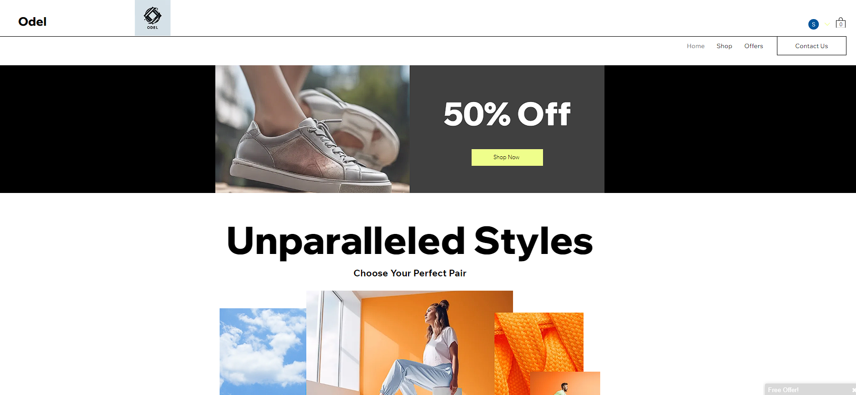
Demonstrate your website
Odel Website

Slide 11

Effective Marketing
Digital marketing offers significant advantages such as global reach, cost-effectiveness, targeted and personalized campaigns, measurable and data-driven efforts, and the ability to provide omnichannel customer experiences.
For Odel, a key strength is the ability to reach a global audience through digital channels and leverage data-driven targeted marketing with measurable and optimizable campaigns, enabling omnichannel customer experiences. However, weaknesses include Odel's limited existing digital presence and brand awareness, lack of in-house digital marketing expertise, and potential budget constraints for comprehensive digital efforts.

Slide 12
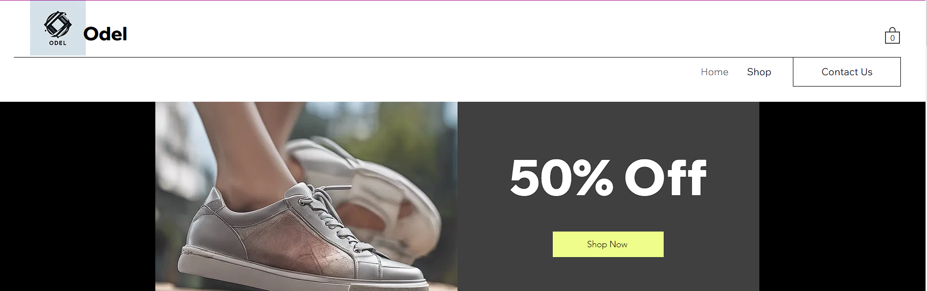
‘Call to action’
To implement “Call to action”, I created a banner at the top of the website with products at 50% discount.

Slide 13
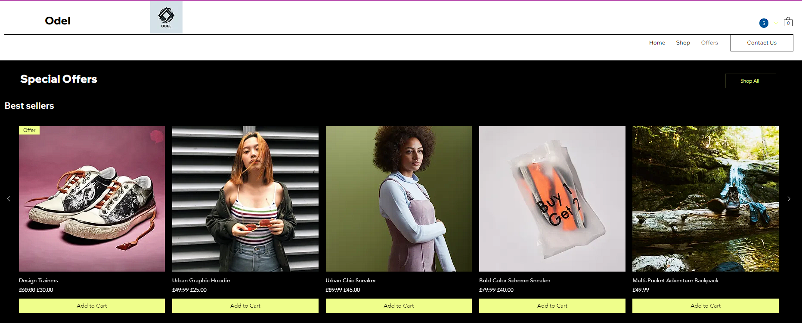
Screenshots

Slide 14

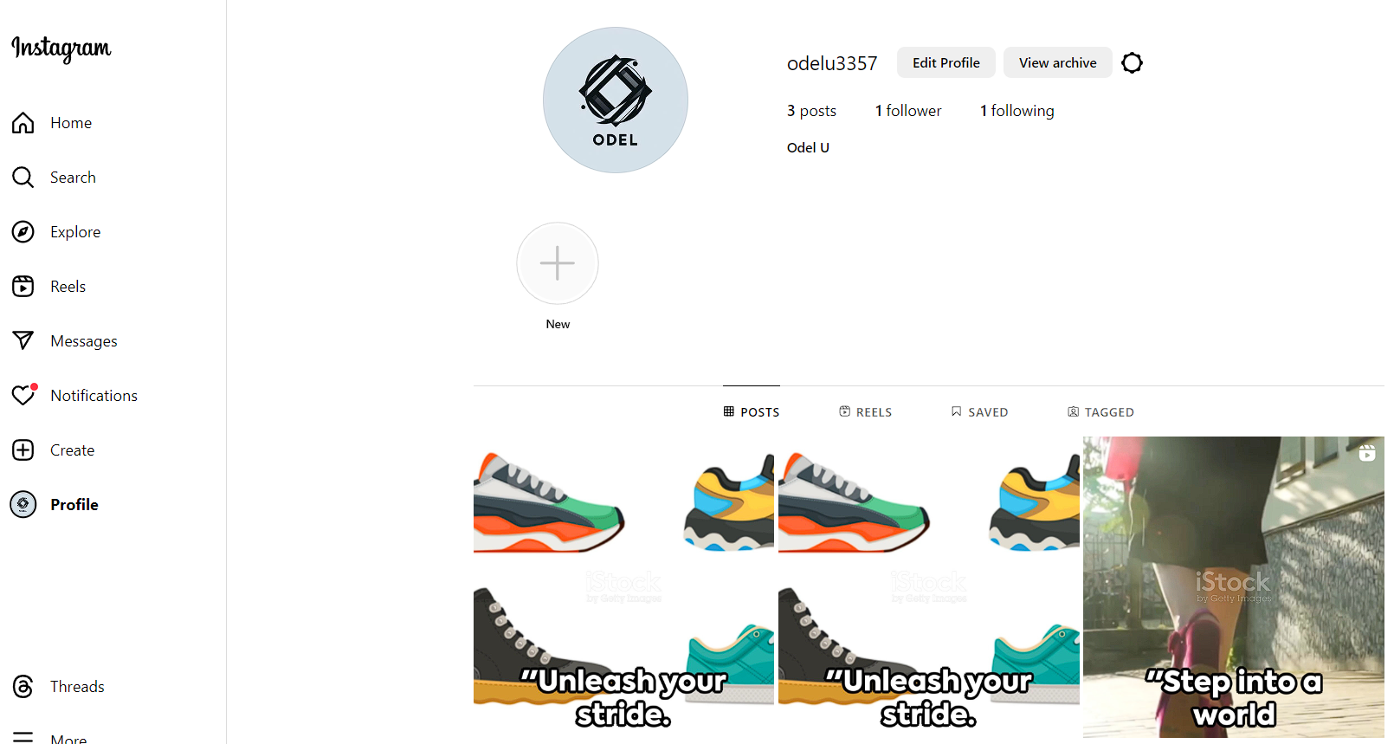
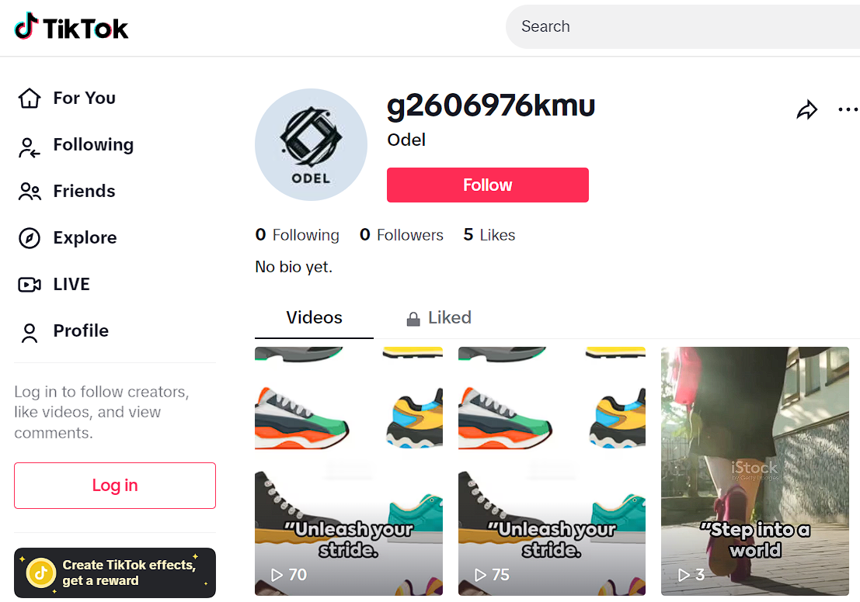
Screenshots

Slide 15
Measurement techniques
To evaluate the performance metrics for digital campaigns using KPIs (Key Performance Indicators), measurable metrics, and analytics platforms, several approaches can be taken. The specific metrics and analytics tools used are:
Website Analytics
Social Media Analytics
Email Marketing Analytics
Notes:
Website Analytics Platforms: Use tools like Google Analytics to track website traffic, user behaviour, and conversion rates.
Key metrics: Sessions, users, pageviews, bounce rate, exit rate, conversion rate, goal completions, e-commerce transactions, and revenue.
Analyse traffic sources, user demographics, device categories, and user flow to understand how users are interacting with the website and identify areas for optimization.
Social Media Analytics: Utilize built-in analytics tools provided by social media platforms (e.g., Facebook Insights, Twitter Analytics, LinkedIn Analytics) or third-party social media analytics tools.
Key metrics: Reach, impressions, engagement (likes, comments, shares), follower growth, click-through rates, and conversion rates from social media traffic.
Analyse audience demographics, popular content, and the performance of paid social media campaigns to understand what resonates with the target audience.
Email Marketing Analytics: Use email marketing platforms like MailChimp, Constant Contact, or HubSpot to track email campaign performance.
Key metrics: Open rates, click-through rates, unsubscribe rates, bounce rates, and conversion rates from email marketing campaigns.
Analyse email list segmentation, subject line effectiveness, and content engagement to optimize future email campaigns.

Slide 16
Improve performance for the store
1. Establish an Online Presence:
Develop a professional website
Set up social media profiles
Implement email marketing
2. Develop a Content Strategy:
Conduct audience research
Create valuable content
Leverage content distribution channels
3.Implement Paid Advertising Campaigns
Identify relevant advertising platforms
Develop targeted ad campaigns
Monitor and optimize campaigns
Notes:
Set 1: Establish an Online Presence
Develop a professional website: Create a user-friendly website that clearly communicates the business's products or services, value proposition, and brand identity. Ensure that the website is optimized for search engines (SEO) and mobile devices.
Set up social media profiles: Create business profiles on relevant social media platforms (e.g., Facebook, Instagram, LinkedIn, Twitter) based on your target audience's preferences. Develop a consistent brand voice and visual identity across these platforms.
Implement email marketing: Build an email list by offering incentives (e.g., discounts, free resources) for subscribers. Create a content calendar and design engaging email campaigns to nurture leads and drive conversions.
Set 2: Develop a Content Strategy
Conduct audience research: Identify your target audience's demographics, interests, pain points, and behaviour patterns. This will inform your content strategy and ensure that your messaging resonates with your audience.
Create valuable content: Develop a content plan that includes a mix of educational, entertaining, and promotional content. Focus on providing solutions to your audience's problems and addressing their interests.
Leverage content distribution channels: Share your content on your website, social media platforms, email marketing campaigns, and consider guest posting or influencer collaborations to expand your reach.
Set 3: Implement Paid Advertising Campaigns
Identify relevant advertising platforms: Based on your target audience's behavior and preferences, select appropriate advertising platforms (e.g., Google Ads, Facebook Ads, Instagram Ads, LinkedIn Ads).
Develop targeted ad campaigns: Create compelling ad copy, visuals, and landing pages that speak directly to your target audience's needs and interests. Experiment with different ad formats and targeting options.
Monitor and optimize campaigns: Continuously track and analyse the performance of your ad campaigns using key metrics such as click-through rate (CTR), cost per click (CPC), and conversion rate. Adjust your targeting, ad creative, and budgets based on the data to optimize performance and maximize return on investment (ROI).

Slide 17
Key digital measurement techniques & performance metrics
Web Analytics
Techniques: Google Analytics, Adobe Analytics, Mixpanel
Key Metrics: Page views, bounce rate, conversion rate, traffic sources
Evaluation: Provides valuable insights into user behaviour and website performance. Data accuracy can be affected by ad blockers, browser settings. May not capture the full customer journey across multiple channels
Social Media Analytics
Techniques: Native platform analytics, third-party tools
Key Metrics: Engagement rates, follower growth, reach, impressions
Evaluation: Tracks audience engagement and content performance Engagement metrics may not correlate with business objectives. Algorithm changes and paid promotion can influence visibility
3. Paid Advertising Analytics
Techniques: Google Ads, Facebook Ads Manager, LinkedIn Campaign Manager
Key Metrics: Click-through rate (CTR), cost-per-click (CPC), conversion rate
Evaluation: Essential for optimizing ad campaigns and measuring ROI Ad fraud, click fraud, and ad blockers can impact accuracy Attribution models may not reflect contribution of different touchpoints

Slide 18
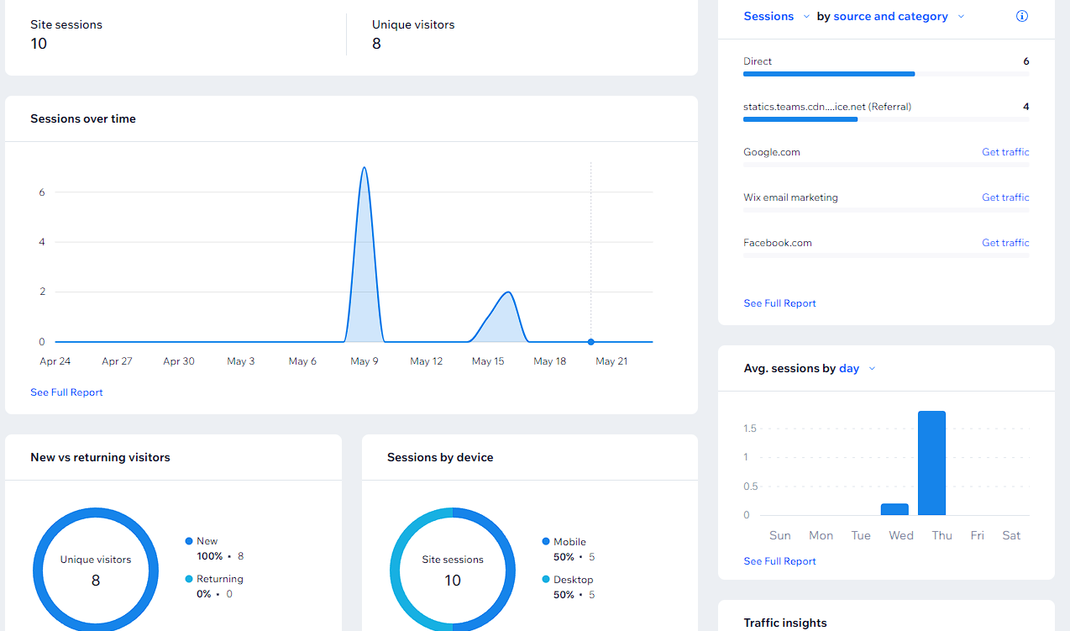
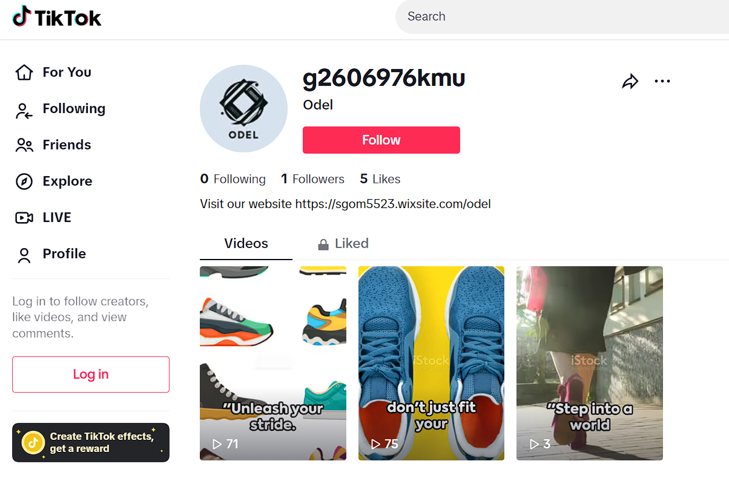
Screenshots

Slide 19
Summary
Summary of Achievements:
Identified the critical need for an online presence across multiple digital channels to reach and engage the target audience effectively.
Developed a comprehensive action plan to establish a strong digital presence, including creating a professional website, setting up social media profiles, implementing email marketing, and exploring paid advertising opportunities.
Emphasized the importance of conducting audience research, developing valuable content, and leveraging content distribution channels to connect with the target audience.
Challenges Faced:
Starting from scratch with no existing digital presence, which can be time-consuming and resource-intensive.
Lack of expertise or resources within the organization to effectively implement and manage digital marketing strategies.
Potential difficulty in identifying the most relevant digital channels and platforms for the target audience.
Overcoming competition and standing out in crowded digital spaces.

Slide 20

Summary
Recommendations:
Develop a Professional Website
Establish a Social Media Presence
Implement Email Marketing
Explore Paid Advertising Opportunities
Seek Professional Assistance or Consulting
Continuously Monitor, Analyse, and Optimize
Notes:
Recommendations:
Develop a Professional Website:
Create a user-friendly, responsive website that clearly communicates the business's products or services, value proposition, and brand identity.
Optimize the website for search engines (SEO) and mobile devices to improve visibility and user experience.
Establish a Social Media Presence:
Set up business profiles on relevant social media platforms based on the target audience's preferences (e.g., Facebook, Instagram, LinkedIn, Twitter).
Develop a consistent brand voice and visual identity across all social media channels.
Create a content calendar and post engaging, valuable content regularly to build an audience and drive engagement.
Implement Email Marketing:
Build an email list by offering incentives (e.g., discounts, free resources) for subscribers.
Design and execute engaging email campaigns, including newsletters, promotional offers, and lead nurturing sequences.
Segment the email list and personalize content to improve relevance and engagement.
Explore Paid Advertising Opportunities:
Identify relevant advertising platforms based on the target audience's behavior and preferences (e.g., Google Ads, Facebook Ads, Instagram Ads, LinkedIn Ads).
Develop targeted ad campaigns with compelling ad copy, visuals, and landing pages that speak directly to the target audience's needs and interests.
Continuously monitor and optimize ad campaigns based on performance metrics to maximize return on investment (ROI).
Seek Professional Assistance or Consulting:
Consider seeking assistance from digital marketing experts or consulting firms if the organization lacks the necessary expertise or resources to execute these strategies effectively.
Leverage their knowledge and experience to develop and implement a comprehensive digital marketing strategy tailored to the business's goals and target audience.
Continuously Monitor, Analyse, and Optimize:
Implement robust analytics and measurement techniques to track the performance of digital marketing efforts across various channels.
Analyse key metrics, such as website traffic, engagement rates, conversion rates, and return on investment (ROI).
Use data-driven insights to continuously optimize and refine digital marketing strategies, content, and campaigns for better results.

Slide 21
“Any Questions?”

Slide 22
REFERENCE
Chaffey, D. and Ellis-Chadwick, F. (2019) Digital Marketing: Strategy, Implementation and Practice. 7th edn. Harlow: Pearson Education Limited.
Clow, K.E. and Baack, D. (2018) Integrated Advertising, Promotion, and Marketing Communications. 8th edn. Harlow: Pearson Education Limited.
Pickton, D. and Broderick, A. (2005) Integrated Marketing Communications. 2nd edn. Harlow: Pearson Education Limited.
Schultz, D.E. and Patti, C.H. (2009) 'The Evolution of IMC: IMC in a Customer-Driven Marketplace', Journal of Marketing Communications, 15(2-3), pp. 75-84.
Chaffey, D. and Ellis-Chadwick, F. (2019) Digital Marketing: Strategy, Implementation and Practice. 7th edn. Harlow: Pearson Education Limited.
Laudon, K.C. and Traver, C.G. (2017) E-Commerce 2017: Business, Technology, Society. 13th edn. Harlow: Pearson Education Limited.
Tuten, T.L. and Solomon, M.R. (2018) Social Media Marketing. 3rd edn. London: SAGE Publications Ltd.

